Slide 1
TITLE SLIDE

Slide 2
Mihimihi
Ko te Aka Mātauranga Matepukupuku tēnei e mihi ake nei
E kōkiri nei i te mātauranga hei āwhina ī ā rātou kua pāngia nei e te matepukupuku
Tūkuna hei te auē, hei te tāngi ā te hunga nei te kaiwhiu i ta mātou kaupapa
Karawhiua!
It is Te Aka Mātauranga Matepukupuku that sends out this greeting
That pushes forward the knowledge to care for those struck by cancer
From these cries, from these tears, shall our purpose be driven forward
Give it your very all!

Slide 3
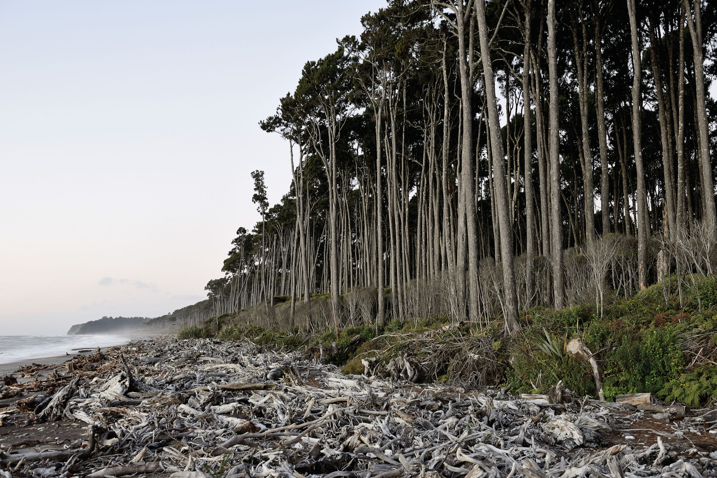
Title
Text
Andrew Shelling
Notes:
Mission statement
Te Aka Mātauranga Matepukupuku
Cancer affects us all and is one of the most important diseases in our society. Most of us will get cancer in our lifetime. We want to die with cancer and not because of it.
The Centre for Cancer Research can make a difference, and we believe that excellent life-saving research done in New Zealand is necessary and important to address one of humanities greatest challenges. Continuing to import western cancer medicine is only going to enhance inequities.
By joining together over 300 of Auckland University’s cancer researchers, we can show national leadership to focus the ambitious transdisciplinary research to drive better outcomes. With time, we will join with the rest of the University, our community partners such as the health system, Maori and Pacific partners, and have an impact within our community.
We want to break down silos within Cancer Research that have developed over the years.
We want to focus on the patient and whanau journey and ensure that we cover the understanding, care, prevention, and treatment of cancer in New Zealand, and we have the broad transdisciplinary team that can do that.
We want to increase equity to a range of groups, but especially to our Maori and Pacific whanau who do disproportionately worse at all levels for cancer outcomes. We are actively building strong Maori and Pacific partnerships.
We want to build and nurture a strong cancer workforce going into the future, especially a pipeline of Maori and Pacific researchers that can lead indigenous cancer research into the future.

Slide 4
Title
Text

Slide 5
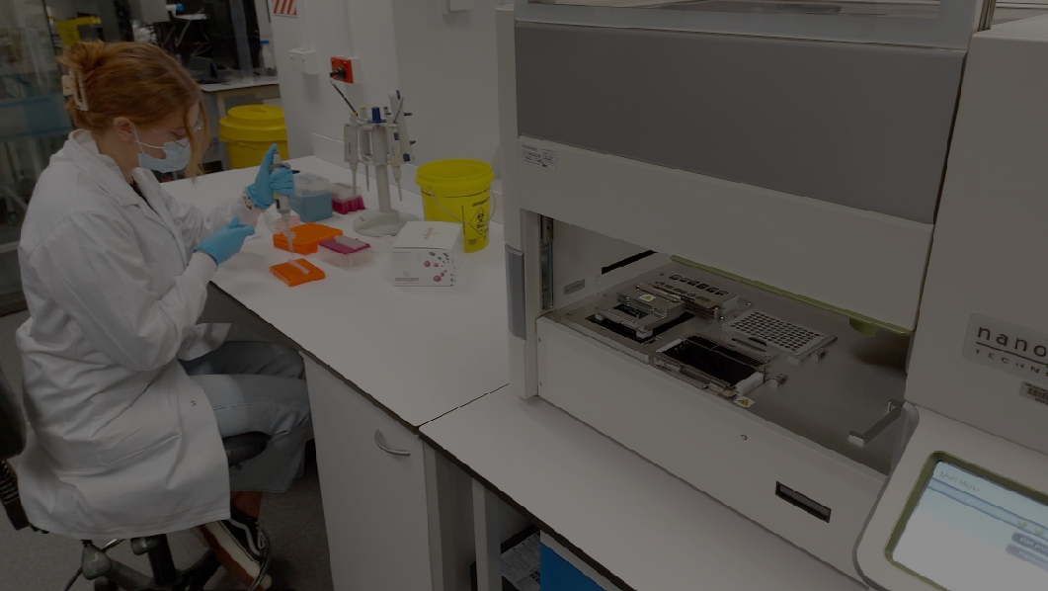
Title
Text
Megan Putterill
Notes:
KEY ISSUES
Cancer is the number one cause of mortality in Aotearoa New Zealand.
Tāngata Māori are disproportionately and unjustly affected by cancer.
The effects on people, whanau and communities are traumatic and far reaching.
Cancer research in Aotearoa New Zealand is increasingly diverse in range and scope.
Without underpinning scholarship, cancer research risks becoming siloed, disjointed, and unable to support excellence and equity of health outcomes.
NATURAL HOME
We will feed Maori and Pacific community engagement back into the research ecosystem. It will make audible the voice of whānau and community affected by cancer.
BRIDGING/JOINING/UNIFYING
It will develop strategic community partnerships resulting in initiatives and projects which benefit partners
It will have co-led governance, seeking NZ unique issues and problems to solve
It will unify the cancer research capacity of the University of Auckland and affiliates and bridge disciplines with a joint goal of socially relevant work, seeking improved health outcomes and equity.
It will develop strategic community partnerships resulting in initiatives and projects which benefit partners
It will have co-led governance, seeking NZ unique issues and problems to solve

Slide 6
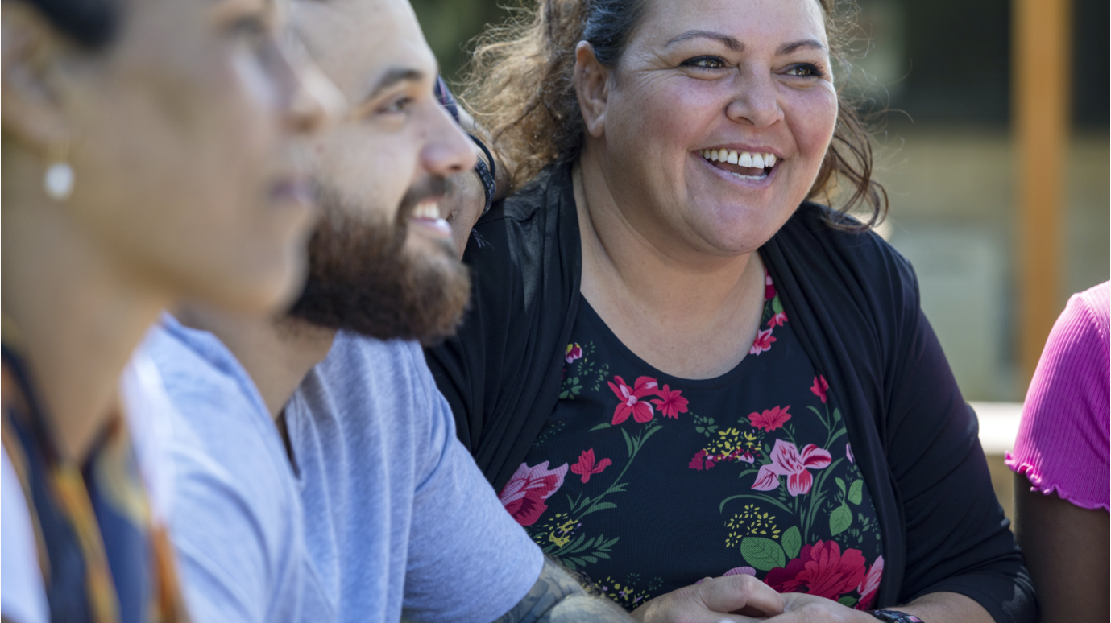
Title
Text
Notes:
KEY ISSUES
Cancer is the number one cause of mortality in Aotearoa New Zealand.
Tāngata Māori are disproportionately and unjustly affected by cancer.
The effects on people, whanau and communities are traumatic and far reaching.
Cancer research in Aotearoa New Zealand is increasingly diverse in range and scope.
Without underpinning scholarship, cancer research risks becoming siloed, disjointed, and unable to support excellence and equity of health outcomes.
NATURAL HOME
We will feed Maori and Pacific community engagement back into the research ecosystem. It will make audible the voice of whānau and community affected by cancer.
BRIDGING/JOINING/UNIFYING
It will develop strategic community partnerships resulting in initiatives and projects which benefit partners
It will have co-led governance, seeking NZ unique issues and problems to solve
It will unify the cancer research capacity of the University of Auckland and affiliates and bridge disciplines with a joint goal of socially relevant work, seeking improved health outcomes and equity.
It will develop strategic community partnerships resulting in initiatives and projects which benefit partners
It will have co-led governance, seeking NZ unique issues and problems to solve

Slide 7
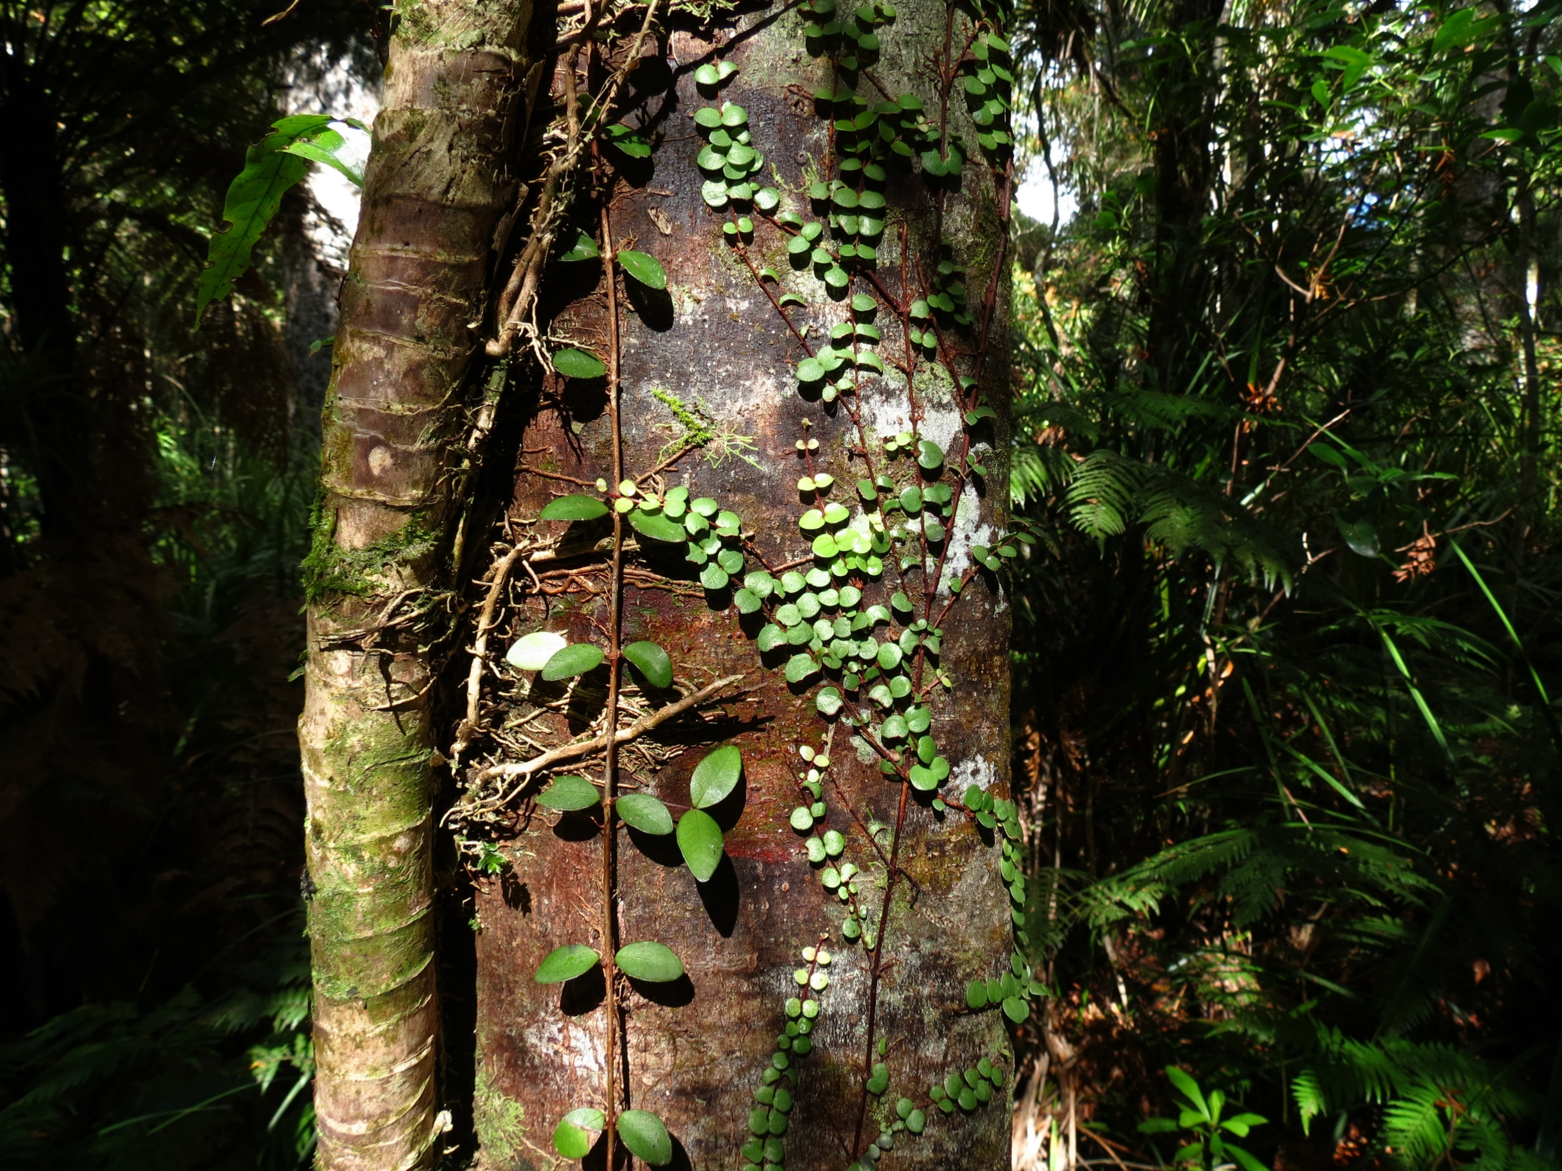
Text
Title

